Slide 1
Statistical Advice for your honour’s project

Slide 2
You do not analyse anything in Rstudio, you do the analysis in R!
An ANOVA is a special type of linear model. Just fit a linear model.
A t-test is a weird type of linear model. Just fit a linear model.
We’re not in the 1990s anymore.

Slide 3
Is my data Normal?
Do not test if your data is “Normally distributed”.
Don’t use histograms to decide if your data is “Normally distributed”.
Normally distributed data will quite often not have a bell shape!
Only textbook examples have the “Normal” distribution.
Even if your supervisor tells you to!!! They’re wrong!!!!!!
Can your data only be positive? Then don’t use a Normal.
Is your data integers? Then don’t use a Normal.
Is your data bound (e.g. between 0 and 1, or 0% and 100%)? Then don’t use a Normal.
Is your data continuous and you want to allow any value between negative and positive infinity? Then use a Normal!

Slide 4
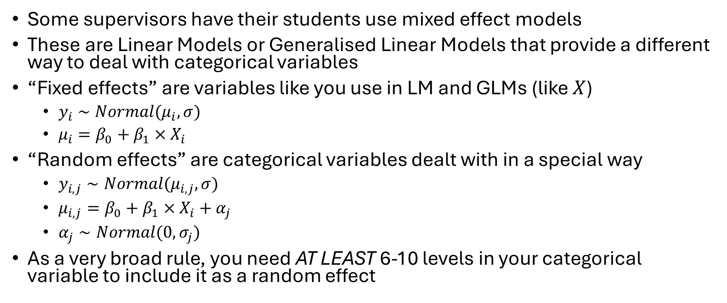
Mixed effect models
Some supervisors have their students use mixed effect models
These are Linear Models or Generalised Linear Models that provide a different way to deal with categorical variables
“Fixed effects” are variables like you use in LM and GLMs (like $X$)
$y_{i}∼Normal(μ_{i}, σ)$
$μ_{i}=β_{0}+β_{1}×X_{i}$
“Random effects” are categorical variables dealt with in a special way
$y_{i,j}∼Normal(μ_{i,j}, σ)$
$μ_{i,j}=β_{0}+β_{1}×X_{i}+α_{j}$
$α_{j}∼Normal(0, σ_{j})$
As a very broad rule, you need AT LEAST 6-10 levels in your categorical variable to include it as a random effect

Slide 5
Equations
I’d encourage you all to try and write the actual equations for your models
Most supervisors won’t check if they are correct (so you won’t be marked down if wrong)
But good for you to learn and actually understand what you are doing!!!

Slide 6
Data

Slide 7
Code
Don’t explain every single little coding choice you make when processing data
Include your code as a supplementary material and everything is done
Most (all?) supervisors won’t check, so you won’t be penalised if it’s wrong
Multiple ways to process code, so there is no “correct” way

